Slide 1

Sports, well-being & self-development
Playing with others
Social skills in team sports
Emotional intelligence
Discipline & Time management
Goal setting
Anger management
Manas K Mandal

Slide 2

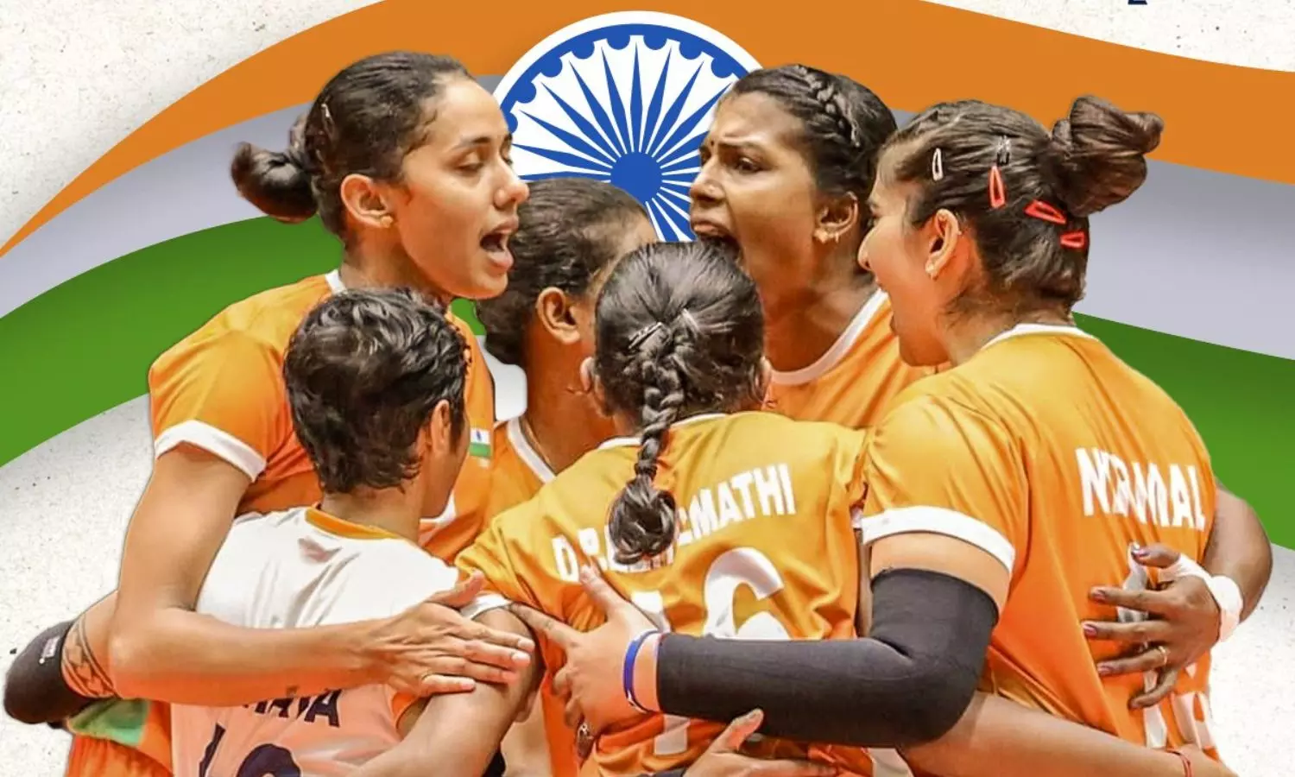
How playing with others boost well-being
Indian Institute of Technology-Kharagpur
Improved physical health: release neurotransmitters, immune functions
Enhanced social skill: cooperation, negotiation, compromise
Increased confidence: a sense of purpose & pride
Instilling discipline : time management, overcoming procrastination
Leadership skills: decision-making & conflict resolution
Communication skills: active listening, constructive feedback

Slide 3
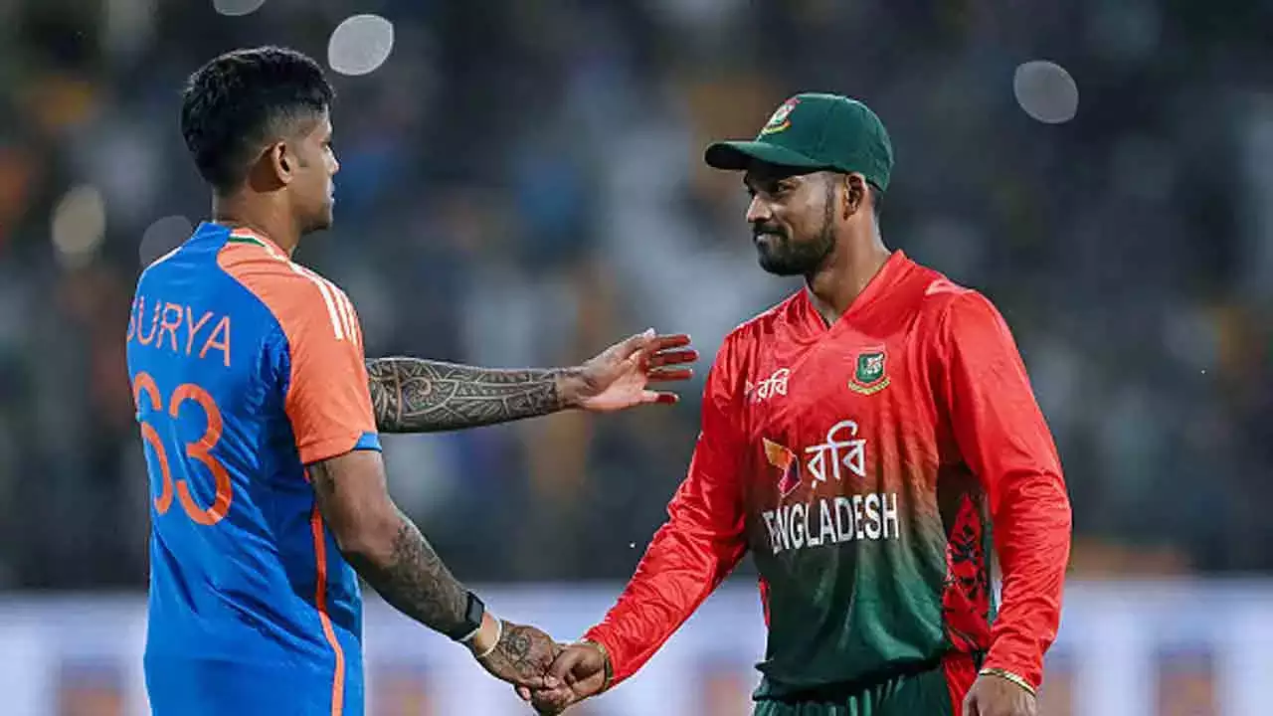
How playing with others boost well-being
Indian Institute of Technology-Kharagpur
Increased cultural awareness: learning about different customs, beliefs, traditions
Goal setting skills: Short- & long-term goals
Resilience: formidable opponent, recovering from an injury, or overcoming a losing streak
Sportsmanship & fair play: learning to win graciously and accept defeat with dignity
Holistic personality development: Emotional intelligence, empathy, mood management

Slide 4
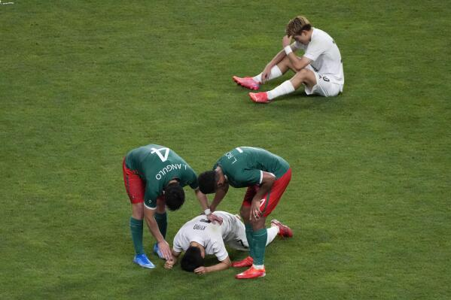
Social skills in team sports
Indian Institute of Technology-Kharagpur
Self-transcendence
Compassion
Empathy
Sympathy
Apathy
Loneliness
Melancholy
I feel for you
I feel with you
I am here to help you

Slide 5
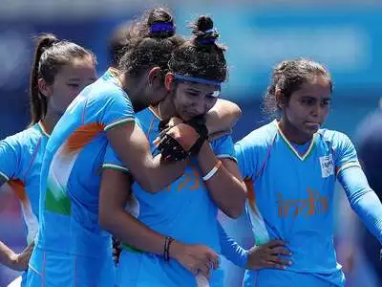
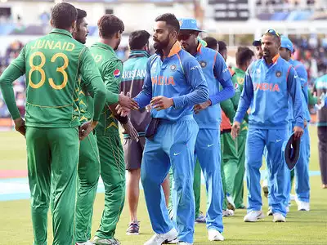
Social skills: Empathy, Mutual respect
Indian Institute of Technology-Kharagpur
Indian Institute of Technology-Kharagpur
Empathy: Experiencing someone else’s feelings
‘Putting your feet in someone else’s shoes’
‘I understand your pain’ vs ‘I feel your pain’
Reflecting before reacting, Giving others more space, communicating at same level

Slide 6
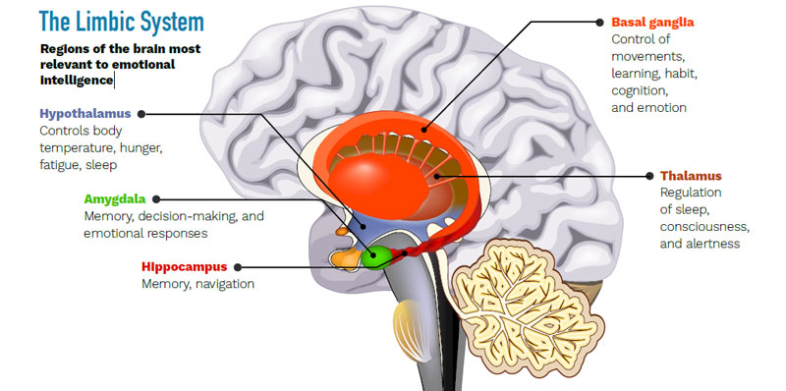
Emotional Intelligence
Indian Institute of Technology-Kharagpur
It is about how we handle ourselves and each other
It goes beyond intellectual ability and technical skills & helps in dealing with negative thoughts
It focuses on personal qualities such as initiative, empathy, adaptability, persuasiveness
A higher Intelligence Quotient does not guarantee happiness or success in life. To succeed, it is not IQ, but EQ plays a bigger role.

Slide 7

Indian Institute of Technology-Kharagpur
When someone you respect humiliates you by making a crack in front of others about a loss in game, you …
Go home & vow never to put yourself in such situation
Make a sharp comeback
Go home & write a letter to defend your position
Make light of it, if you can and then privately tell the person how you felt
Emotional Intelligence

Slide 8
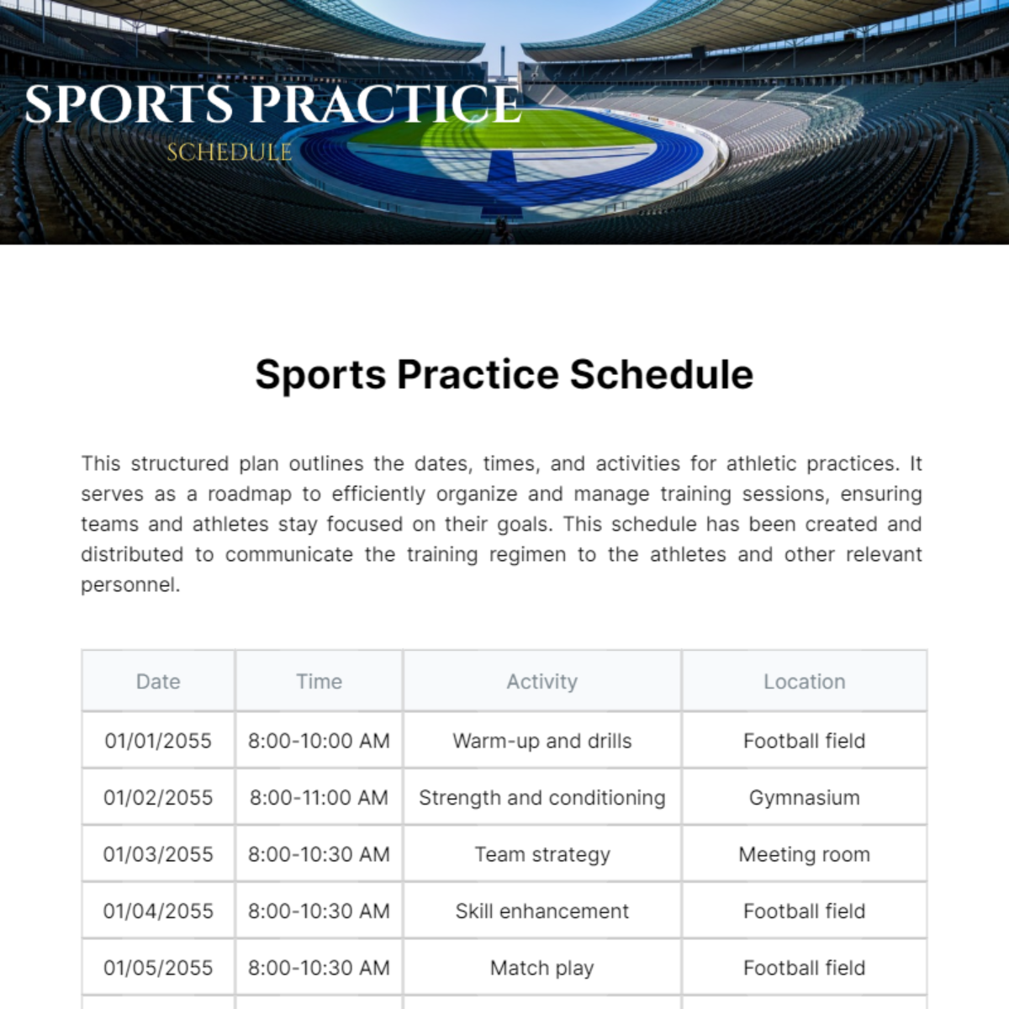
Discipline & Time management
Indian Institute of Technology-Kharagpur
…is the process of planning & exercising conscious control of time spent on specific activities—especially to increase effectiveness, efficiency, and productivity.
…the byproducts of time management is improved focus. With a well-structured schedule, one can fully immerse in whatever task is at hand—be it a practice session, a workout, or a study session

Slide 9
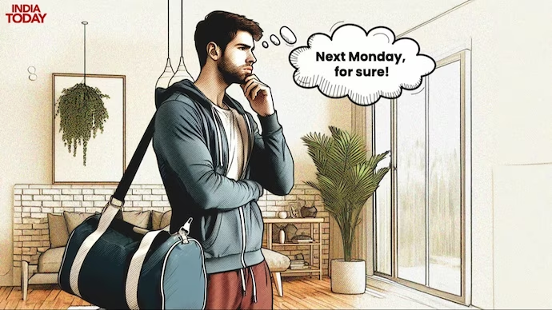
Procrastination
Indian Institute of Technology-Kharagpur
It’s a struggle of self-regulation, impulse control, especially for physical exercise
They create obstacles for themselves, a self-defeating tendency… via mental justification
Procrastinators suffer from ‘temporal discounting’; tend to avoid task that appears unpleasant
They suffer from an unconscious sense of inadequacy

Slide 10

Goal setting
Indian Institute of Technology-Kharagpur
…is a powerful process for thinking about your ideal future and for motivating yourself to turn your vision of this future into reality
…setting life goals gives you the overall perspective that shapes all aspects of our decision making
Short term goal (within 1 year)
Intermediate term goal (within 1 – 5 year)
Long term goal (beyond 5 year)

Slide 11
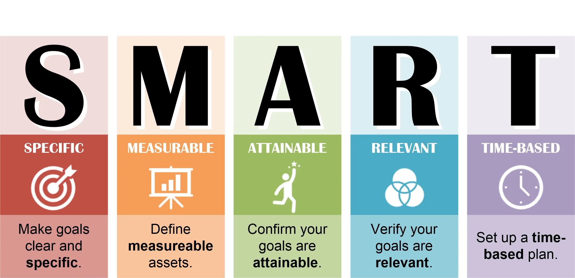
Goal setting:
Indian Institute of Technology-Kharagpur
Goals need to be specific – expected outcome. ‘I need to do 50 laps a day for the next 30 days’
Goals need to be measurable - specific criteria for measuring progress. ‘I want to be able to cover 200mt in 25sec’
Goals need to be attainable - realistic outcome given our current situation, resources and available time
Goals should be relevant in our journey towards meeting larger life outcomes
Goals need to have a structured around a time frame when you want to achieve them

Slide 12
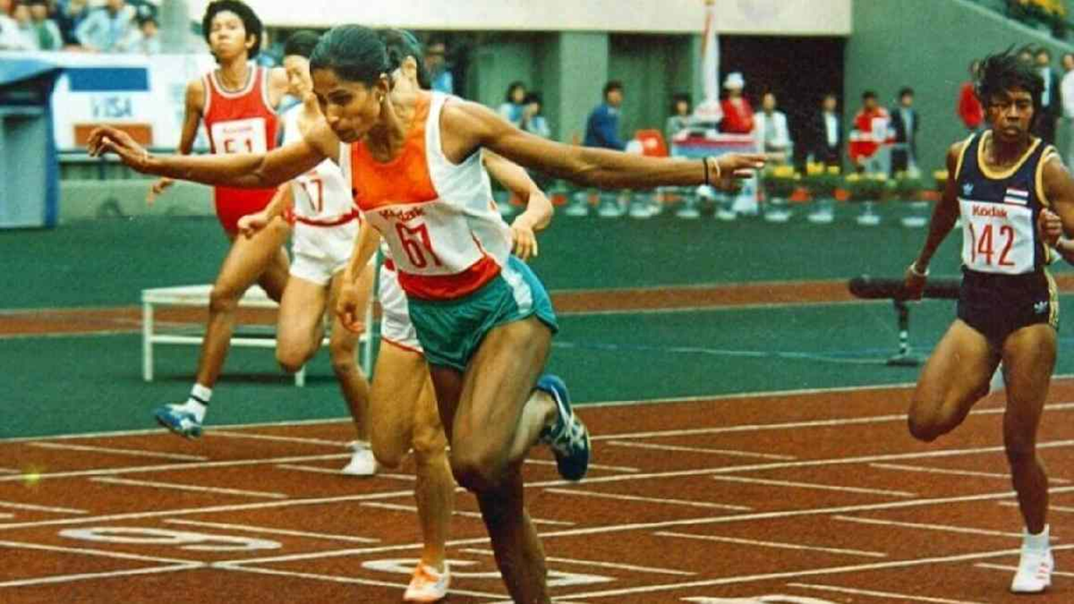
Goal setting in sports
Indian Institute of Technology-Kharagpur
“A goal is like a roadmap; it shows the way to a destination. But unlike a physical road, there are often many ways to reach these goals, and the journey can be full of twists and turns”.
“A goal gives you something to strive for and stay motivated when the going gets tough. It’s a reminder of where you’re trying to go and what you’re trying to achieve”
https://traceup.com/setting-goals-in-sports
Notes:
https://traceup.com/setting-goals-in-sports

Slide 13
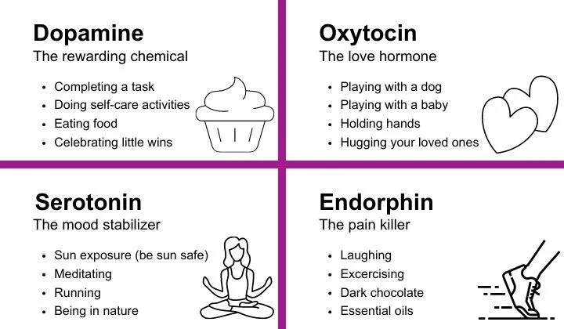
Mood, emotion & sports
Indian Institute of Technology-Kharagpur
Motivation and drive: Passion, excitement, activate the reward centers in the brain and trigger the release of neurotransmitters like dopamine, which are associated with pleasure & motivation
Focus and concentration: Positive emotions activate the prefrontal cortex, the part of the brain responsible for executive functions like attention, planning, decision-making
Recovery and Resilience: Positive emotions can stimulate the release of hormones such as endorphins and oxytocin, which can help reduce stress and inflammation in the body

Slide 14
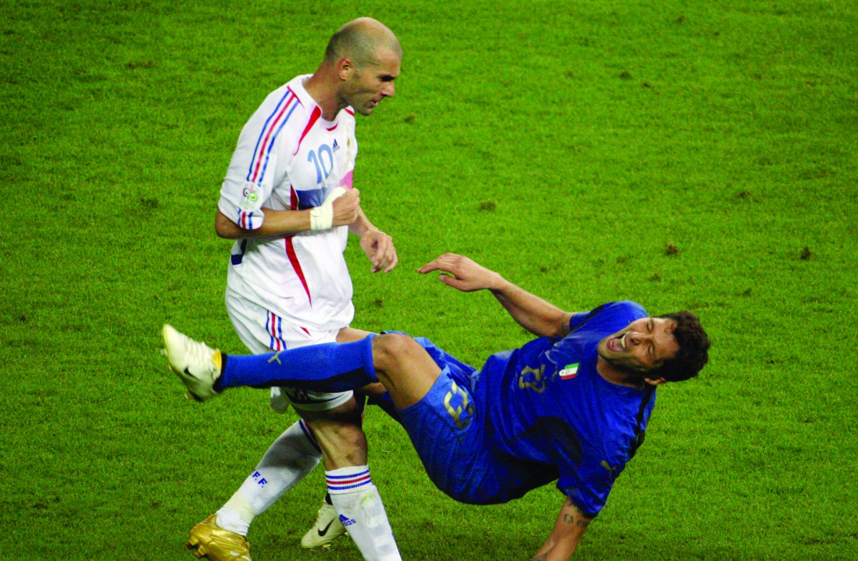
Aggression management
Indian Institute of Technology-Kharagpur
In sport, aggression has negative as well as positive effects on performance
Most people view aggression as a negative; however, some agree that aggression can improve performance (Widmeyer & Birch, 1984).
When athletes experience frustration, (e.g., perceived injustice, failure to meet a goal, or an obstacle in their way, they may act aggressively towards others [Frustration-aggression theory, Berkowitz, 1989]

